Slide 1
What have we learned about learning?
Statistical learning
Mathematically rigorous, general approach
Requires probabilistic expression of likelihood, prior
Decision trees (classification)
Learning concepts that can be expressed as logical statements
Statement must be relatively compact for small trees, efficient learning
Function learning (regression / classification)
Optimization to minimize fitting error over function parameters
Function class must be established a priori
Neural networks (regression / classification)
Can tune arbitrarily sophisticated hypothesis classes
Unintuitive map from network structure => hypothesis class

Slide 2
Support Vector Machines

Slide 3
Motivation: Feature Mappings
Given attributes x, learn in the space of features f(x)
E.g., parity, FACE(card), RED(card)
Hope CONCEPT is easier to learn in feature space

Slide 4
Example
x₂
x₁

Slide 5
Example
Choose f₁=x₁², f₂=x₂², f₃=√2 x₁x₂
x₂
f₃
f₂
f₁
x₁

Slide 6
VC dimension
In an N dimensional feature space, there exists a perfect linear separator for n <= N+1 examples no matter how they are labeled
?
+
-
+
-
+
-
+
+
-
-

Slide 7
SVM Intuition
Find “best” linear classifier in feature space
Hope to generalize well

Slide 8
Linear classifiers
Plane equation: 0 = x₁θ₁ + x₂θ₂ + … + x_{n}θ_{n} + b
If x₁θ₁ + x₂θ₂ + … + x_{n}θ_{n} + b > 0, positive example
If x₁θ₁ + x₂θ₂ + … + x_{n}θ_{n} + b < 0, negative example
Separating plane

Slide 9
Linear classifiers
Plane equation: 0 = x₁θ₁ + x₂θ₂ + … + x_{n}θ_{n} + b
If x₁θ₁ + x₂θ₂ + … + x_{n}θ_{n} + b > 0, positive example
If x₁θ₁ + x₂θ₂ + … + x_{n}θ_{n} + b < 0, negative example
Separating plane
(θ₁,θ₂)

Slide 10
Linear classifiers
Plane equation: x₁θ₁ + x₂θ₂ + … + x_{n}θ_{n} + b = 0
C = Sign(x₁θ₁ + x₂θ₂ + … + x_{n}θ_{n} + b)
If C=1, positive example, if C= -1, negative example
Separating plane
(θ₁,θ₂)
(-bθ₁, -bθ₂)

Slide 11
Linear classifiers
Let w = (θ₁,θ₂,…,θ_{n}) (vector notation)
Special case: ||w|| = 1
b is the offset from the origin
The hypothesis space is the set of all (w,b), ||w||=1
Separating plane
w
b

Slide 12
Linear classifiers
Plane equation: 0 = w^{T}x + b
If w^{T}x + b > 0, positive example
If w^{T}x + b < 0, negative example

Slide 13
SVM: Maximum Margin Classification
Find linear classifier that maximizes the margin between positive and negative examples
Margin

Slide 14
Margin
The farther away from the boundary we are, the more “confident” the classification
Margin
Not as confident
Very confident

Slide 15
Geometric Margin
The farther away from the boundary we are, the more “confident” the classification
Margin
Distance of example to the boundary is its geometric margin

Slide 16

Geometric Margin
Let y_{i} = -1 or 1
Boundary w^{T}x + b = 0, $\left\|w\right\|$=1
Geometric margin is y^{(i)}(w^{T}x^{(i)} + b)
SVMs try to optimize the minimum margin over all examples
Margin
Distance of example to the boundary is its geometric margin

Slide 17

Maximizing Geometric Margin
max_{w,b,m} m
Subject to the constraints m ≤ y^{(i)}(w^{T}x^{(i)} + b), $\left\|w\right\|$=1
Margin
Distance of example to the boundary is its geometric margin

Slide 18

Maximizing Geometric Margin
min_{w,b} $\left\|w\right\|$
Subject to the constraints 1 ≤ y^{(i)}(w^{T}x^{(i)} + b)
Margin
Distance of example to the boundary is its geometric margin

Slide 19
Key Insights
The optimal classification boundary is defined by just a few (d+1) points: support vectors
Margin

Slide 20
Using “Magic” (Lagrangian duality, Karush-Kuhn-Tucker conditions)…
Can find an optimal classification boundary w = Σ_{i} α_{i} y^{(i)} x^{(i)}
Only a few α_{i}’s at the SVs are nonzero (n+1 of them)
… so the classification w^{T}x = Σ_{i} α_{i} y^{(i)} x^{(i)T}x can be evaluated quickly

Slide 21
The Kernel Trick
Classification can be written in terms of (x^{(i)T} x)… so what?
Replace inner product (a^{T} b) with a kernel function K(a,b)
K(a,b) = f(a)^{T} f(b) for some feature mapping f(x)
Can implicitly compute a feature mapping to a high dimensional space, without having to construct the features!

Slide 22
Kernel Functions
Can implicitly compute a feature mapping to a high dimensional space, without having to construct the features!
Example: K(a,b) = (a^{T}b)²
(a₁b₁ + a₂b₂)² = a₁²b₁² + 2a₁b₁a₂b₂ + a₂²b₂² = [a₁² , a₂² , √2a₁a₂]^{T}[b₁² , b₂² , √2b₁b₂]
An implicit mapping to feature space of dimension 3 (for n attributes, dimension n(n+1)/2)

Slide 23
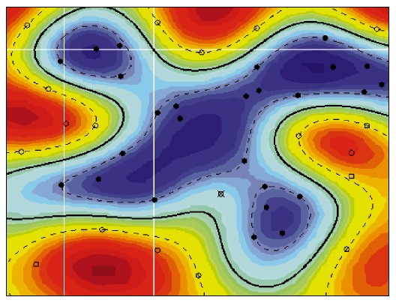
Types of Kernel
Polynomial K(a,b) = (a^{T}b+1)^{d}
Gaussian K(a,b) = exp(-||a-b||²/σ²)
Sigmoid, etc…
Decision boundaries in feature space may be highly curved in original space!

Slide 24
Kernel Functions
Feature spaces:
Polynomial: Feature space is exponential in d
Gaussian: Feature space is infinite dimensional
N data points are (almost) always linearly separable in a feature space of dimension N-1
=> Increase feature space dimensionality until a good fit is achieved

Slide 25
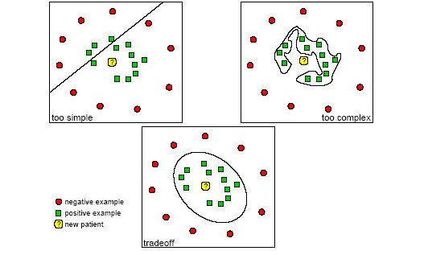
Overfitting / underfitting

Slide 26
Nonseparable Data
Cannot achieve perfect accuracy with noisy data
Regularization parameter:
Tolerate some errors, cost of error determined by some parameter C
Higher C: more support vectors, lower error
Lower C: fewer support vectors, higher error

Slide 27
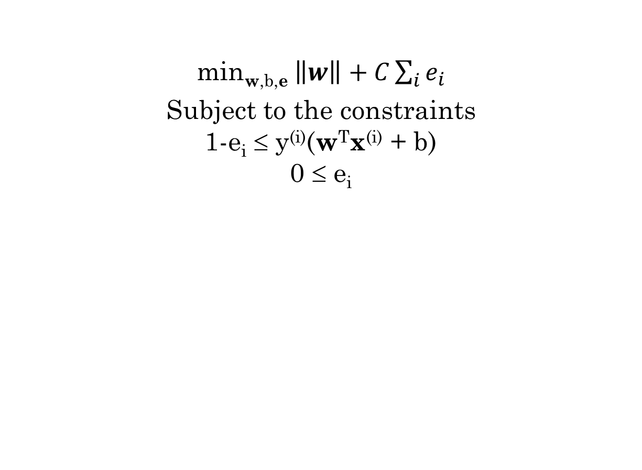
Soft Geometric Margin
Regularization parameter
min_{w,b,e} $\left\|w\right\|+C\sum_{i}{e_{i}}$
Subject to the constraints 1-e_{i} ≤ y^{(i)}(w^{T}x^{(i)} + b) 0 ≤ e_{i}
Slack variables: nonzero only for misclassified examples

Slide 28
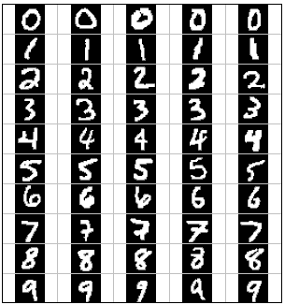
Comments
SVMs often have very good performance
E.g., digit classification, face recognition, etc
Still need parameter tweaking
Kernel type
Kernel parameters
Regularization weight
Fast optimization for medium datasets (~100k)
Off-the-shelf libraries
SVM^{light}

Slide 29
Nonparametric Modeling (memory-based learning)

Slide 30
So far, most of our learning techniques represent the target concept as a model with unknown parameters, which are fitted to the training set
Bayes nets
Least squares regression
Neural networks
[Fixed hypothesis classes]
By contrast, nonparametric models use the training set itself to represent the concept
E.g., support vectors in SVMs

Slide 31
Example: Table lookup
Values of concept f(x) given on training set D = {(x_{i},f(x_{i})) for i=1,…,N}
Example space X
-
+
-
-
+
-
-
-
-
+
+
+
+
-
-
+
Training set D
+
+
+
-
-
-
+
+

Slide 32
Example: Table lookup
Values of concept f(x) given on training set D = {(x_{i},f(x_{i})) for i=1,…,N}
On a new example x, a nonparametric hypothesis h might return
The cached value of f(x), if x is in D
FALSE otherwise
Example space X
-
+
-
-
+
-
-
-
-
+
+
+
+
-
-
+
Training set D
+
+
+
-
-
-
+
A pretty bad learner, because you are unlikely to see the same exact situation twice!
+

Slide 33
Nearest-Neighbors Models
Suppose we have a distance metric d(x,x’) between examples
A nearest-neighbors model classifies a point x by:
Find the closest point x_{i} in the training set
Return the label f(x_{i})
X
+
-
+
-
-
+
+
-
-
+
Training set D
-
+

Slide 34
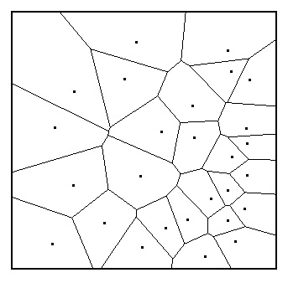
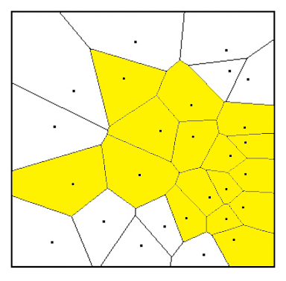
Nearest Neighbors
NN extends the classification value at each example to its Voronoi cell
Idea: classification boundary is spatially coherent (we hope)
Voronoi diagram in a 2D space

Slide 35
Distance metrics
d(x,x’) measures how “far” two examples are from one another, and must satisfy:
d(x,x) = 0
d(x,x’) ≥ 0
d(x,x’) = d(x’,x)
Common metrics
Euclidean distance (if dimensions are in same units)
Manhattan distance (different units)
Axes should be weighted to account for spread
d(x,x’) = α_{h}|height-height’| + α_{w}|weight-weight’|
Some metrics also account for correlation between axes (e.g., Mahalanobis distance)

Slide 36
Properties of NN
Let:
N = |D| (size of training set)
d = dimensionality of data
Without noise, performance improves as N grows
k-nearest neighbors helps handle overfitting on noisy data
Consider label of k nearest neighbors, take majority vote
Curse of dimensionality
As d grows, nearest neighbors become pretty far away!

Slide 37
Curse of Dimensionality
Suppose X is a hypercube of dimension d, width 1 on all axes
Say an example is “close” to the query point if difference on every axis is < 0.25
What fraction of X are “close” to the query point?
?
?
d=2
d=3
d=10
d=20
0.5² = 0.25
0.5³ = 0.125
0.5¹⁰ = 0.00098
0.5²⁰ = 9.5x10⁻⁷

Slide 38
Computational Properties of K-NN
Training time is nil
Naïve k-NN: O(N) time to make a prediction
Special data structures can make this faster
k-d trees
Locality sensitive hashing
… but are ultimately worthwhile only when d is small, N is very large, or we are willing to approximate
See R&N

Slide 39
Nonparametric Regression
Back to the regression setting
f is not 0 or 1, but rather a real-valued function
f(x)
x

Slide 40
Nonparametric Regression
Linear least squares underfits
Quadratic, cubic least squares don’t extrapolate well
Cubic
f(x)
Linear
Quadratic
x

Slide 41
Nonparametric Regression
“Let the data speak for themselves”
1st idea: connect-the-dots
f(x)
x

Slide 42
Nonparametric Regression
2nd idea: k-nearest neighbor average
f(x)
x

Slide 43
Locally-weighted Averaging
3rd idea: smoothed average that allows the influence of an example to drop off smoothly as you move farther away
Kernel function K(d(x,x’))
K(d)
d=0
d=d_{max}
d

Slide 44
Locally-weighted averaging
Idea: weight example i by w_{i}(x) = K(d(x,x_{i})) / [Σ_{j} K(d(x,x_{j}))](weights sum to 1)
Smoothed h(x) = Σ_{i} f(x_{i}) w_{i}(x)
x_{i}
f(x)
w_{i}(x)
x

Slide 45
Locally-weighted averaging
Idea: weight example i by w_{i}(x) = K(d(x,x_{i})) / [Σ_{j} K(d(x,x_{j}))](weights sum to 1)
Smoothed h(x) = Σ_{i} f(x_{i}) w_{i}(x)
x_{i}
f(x)
w_{i}(x)
x

Slide 46
What kernel function?
Maximum at d=0, asymptotically decay to 0
Gaussian, triangular, quadratic
K_{parabolic}(d)
K_{gaussian}(d)
K_{triangular}(d)
d=0
d
0
d_{max}

Slide 47
Choosing kernel width
Too wide: data smoothed out
Too narrow: sensitive to noise
x_{i}
f(x)
w_{i}(x)
x

Slide 48
Choosing kernel width
Too wide: data smoothed out
Too narrow: sensitive to noise
x_{i}
f(x)
w_{i}(x)
x

Slide 49
Choosing kernel width
Too wide: data smoothed out
Too narrow: sensitive to noise
x_{i}
f(x)
w_{i}(x)
x

Slide 50
Extensions
Locally weighted averaging extrapolates to a constant
Locally weighted linear regression extrapolates a rising/decreasing trend
Both techniques can give statistically valid confidence intervals on predictions
Because of the curse of dimensionality, all such techniques require low d or large N

Slide 51
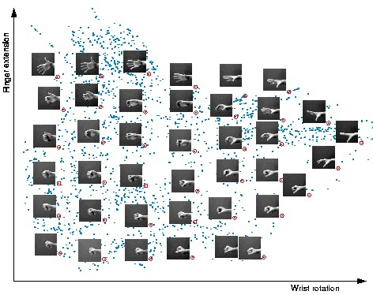
Aside: Dimensionality Reduction
Many datasets are too high dimensional to do effective learning
E.g. images, audio, surveys
Dimensionality reduction: preprocess data to a find a low # of features automatically

Slide 52
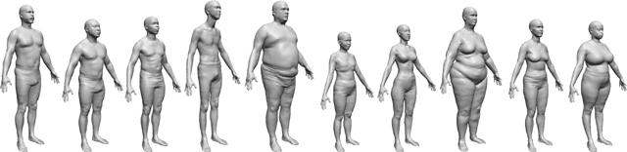
Principal component analysis
Finds a few “axes” that explain the major variations in the data
Related techniques: multidimensional scaling, factor analysis, Isomap
Useful for learning, visualization, clustering, etc
University of Washington

Slide 53
Project Mid-term Report
October 30:
1-2 page description of current progress, challenges, changes in direction

Slide 54
Next time
In a world with a slew of machine learning techniques, feature spaces, training techniques…
How will you:
Prove that a learner performs well?
Compare techniques against each other?
Pick the best technique?
R&N 18.4-5

